Slide 1
DevOps Overview Instructor: David Ernst

Slide 2











Introduction – David Ernst
Sr. Specialist SA – DevOps/GenAI, AWS
(Next Generation Developer Experience)
BA – University Of Toledo
Replace it with Instructor Name/background/related photographs to introduce to learners

Slide 3
Hook
Let's dive into Amazon’s DevOps and CI/CD Process
Speed: Faster releases with fewer manual steps.
Reliability: Fewer errors due to automation.
Consistency: Uniform processes across multiple teams and environments.
Jenkins is a popular CI/CD tool within DevOps
Offering flexibility and scalability.
Notes:
Introduction to CI/CD: Discuss how continuous integration and delivery pipelines are used to automate deployment in large-scale environments like Amazon’s.
2009
Chapter 1: What Is DevOps? The word “DevOps” was coined in 2009 by Patrick Debois, who became one of its gurus.

Slide 4
Learning Objective
Understand DevOps
Grasp Discover the collaborative practices and cultural shifts in DevOps that accelerate development and operations.
Understand the role of CI/CD in DevOps
Grasp the basic principles of Continuous Integration (CI) and Continuous Deployment (CD)
Explore Jenkins as a Key CI/CD Tool
Learn Jenkins essentials for setting up automated pipelines
Hands-on Application
Gain practical insights into pipeline setup and automation steps

Slide 5
Agenda
Introduction to DevOps at Amazon and other organizations
Basics of Jenkins in a CI/CD Context
Jenkins Pipeline Setup and use cases
Demo

Slide 6
Audience
DevOps/SRE Engineers
Skilled in CI/CD, Cloud, and Infrastructure as Code
Focused on solving high-impact, complex problems
Preparing one for a roles in top tech companies
Notes:
Target Audience:
Experienced DevOps and Site Reliability Engineers with 7+ years in the industry, aiming to excel in high-level interviews for top tech companies.
Technical Foundation: Proficient in CI/CD, monitoring, cloud platforms, and automation tools (e.g., Jenkins, Docker, Kubernetes).
Problem-Solving Focus: Skilled in diagnosing and resolving complex system challenges, they seek strategies for conveying this during interviews.
Career Advancement: Motivated to master advanced concepts in CI/CD and scalable deployments, positioning themselves for roles with greater responsibility.
Interview Readiness: Looking to demonstrate technical depth and decision-making skills through real-world application, particularly in CI/CD, scalability, and resilience contexts.
This audience values actionable insights tailored to high-stakes interview scenarios with a focus on optimization and strategic thinking.

Slide 7
The Four Laws of Amazon DevOps**
1.
2.
3.
4.
Break things down
Teams are autonomous businesses
Automate everything
Manage the things that matter
**Strictly according to me

Slide 8
Starting out
User
Business
This is how many web architectures started out, and it’s how Amazon started too…
There any many bottlenecks, and scaling of the web server was an immediate factor
Internet
Processing
Web server
Remote Facility
Table 1
Table 1
Table 2
Table 3
Table 3
Database

Slide 9
Scaling Mark I
User
Business
This was a bit better, but still not very scalable
In 1998 the “Distributed Computing Manifesto” came out and we began breaking things down into separate components…
Internet
Processing
Web Server
Remote Facility
Table 1
Table 2
Table 3
Table 1
Database
Table 3
Web DB
Web DB

Slide 10
Breaking things down
Principles
Make units a small as possible
Create data domains
De-couple based on scaling factors, not functions
Each service operates independently
APIs (contracts) between services
This led to changes in organization

Slide 11
Getting (re)organized
“Two-pizza” teams
Own a service
Minimizes social constraints (Conway’s law)
Autonomy to make decisions

Slide 12
Getting (re)organized
Own everything
Planning
Security
Performance
Scalability
Deployment
Operation
Bugs
Documentation
Testing…
How can one team do all of this?

Slide 13
Automate everything
Development
Mid Stage(s)
Production
Speed is Critical
Quality is Critical
Master
Box
Fleet
R1
Fully automated deployment
Box
Fleet
R2
Pessimistic
rules & tests
Integration
Box
Fleet
R3
Load
Security
Small changes
Best Practice Templates
Notes:
At Amazon, we focus on continuous deployment, not just delivery, gradually enhancing this process over time.
Emphasizing on more rigorous testing has led us to achieve higher quality outputs and enable smaller releases.
We follow a 'fan out model', which means our deployments get progressively closer to production as they pass through the pipeline.
We kick-start our projects by relying on templates that capture the best practices.
Adopting a 'pessimistic view', we aim to find any possible reason that could cause a deployment to fail and address it proactively.
Security is a responsibility shared by everyone. Our security team's goal is to NOT block projects, which means they have to get involved at an early stage.

Slide 14
Managing success
Business metrics
Operational metrics
Input goals
Enablement
Growth
Errors
Features
Principal reviews
Usage
Throttling
Use cases
Security training
Feedback
Failed deployments
Performance
Ops training
Performance
Features

Slide 15
Today we have Modern Applications
Modern Application
Does one thing
Independent deployments
Independent scaling
Small impact of change
Choice of technology

Slide 16
Today we have Modern Applications
Modern Applications
Use independently scalable microservices (serverless, containers...)
Connect through APIs
Deliver updates continuously
Adapt quickly to change
Scale globally
Are fault tolerant
Carefully mange state and persistence
Have security built-in

Slide 17
17
Development transformation at Amazon: 2001–2002
1994-2001
2002+
Decoupled services +
Two-pizza teams
1000+ Microservices
100+ purpose-built databases
Monolithic architecture + hierarchical organization

Slide 18
Deployment: Monolith development lifecycle
developers
services
delivery pipelines
build
test
release
monitor

Slide 19
Deployment: Microservices development lifecycle
developers
services
delivery pipelines
build
test
release
monitor
build
test
release
monitor
build
test
release
monitor
build
test
release
monitor
build
test
release
monitor
build
test
release
monitor

Slide 20
How would you describe the CI/CD process to a non-technical stakeholder?
Notes:
CI/CD stands for Continuous Integration and Continuous Deployment, and it’s a method used by development teams to build and release software in small, manageable parts. Imagine you’re working on a new feature for an app; instead of waiting until the end to test it all at once, CI/CD lets us automatically test and integrate each small change in real time. This way, we catch and fix issues early and often.
With Continuous Integration, we automatically test code every time it’s updated, so we know immediately if something doesn’t work as expected. Continuous Deployment means that once a change passes all tests, it can be quickly and safely rolled out to users without manual steps.
This approach not only speeds up development but also reduces the risk of big issues because we’re constantly ensuring everything works together. Overall, CI/CD helps us deliver new features, improvements, and bug fixes to users more efficiently and reliably.”
This explanation keeps it high-level and focuses on the benefits like faster delivery and reliability, making it relatable to non-technical stakeholders.

Slide 21





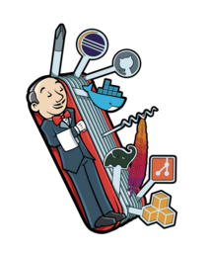


Re-architecting Jenkins?
Mature technology
(17+ years)
Rich plugins (1800+)
Awesome community

Slide 22
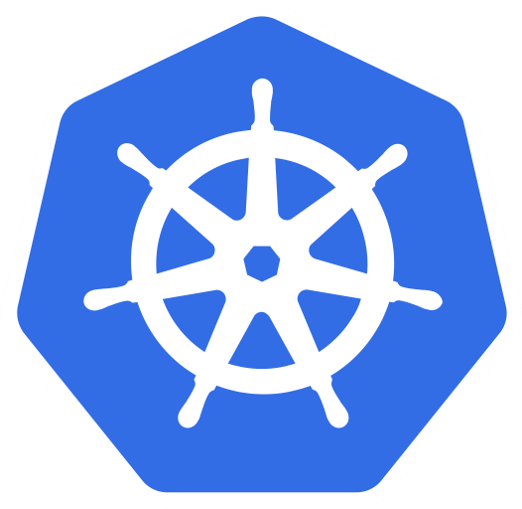







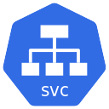

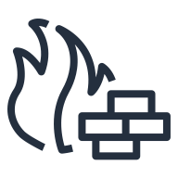


Jenkins : multigenerational compute platform
On-premise
Cloud
kubernetes
VPC
Auto Scaling group
On-demand
Server Farm
Spot Fleet

Slide 23




Jenkins on Container & Kubernetes
Run everywhere & consistent
Responsive deployment & scaling
Version control Jenkins
Micro Jenkins agent
Clean environments
Job isolation
Disposability
Agent and node orchestration
Higher density

Slide 24
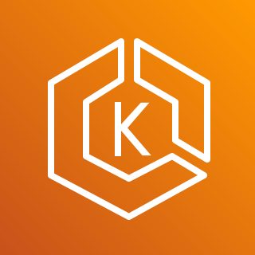


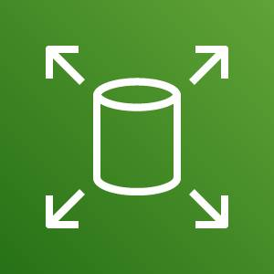
Jenkins on EKS – Architecture View
Amazon Elastic Kubernetes Service
Single Node
Availability Zone (AZ)
Starting point
Persistent storage
Data replicated within AZ
99.999% storage availability
Snapshot as backup
Amazon EKS
persistent volume
Amazon EBS

Slide 25
Jenkins on EKS – Architecture View
High Availability Options
Multi node HA in single AZ
Availability Zone (AZ)
Multi worker node
Snapshot as backup
Amazon EKS
persistent volume
Amazon EBS

Slide 26


Jenkins on EKS – Architecture View
Expanding with Elastic File System
Multi AZ high availability with EFS
Availability Zone (AZ)
Availability Zone (AZ)
Multi-AZ fault tolerant
Shared storage
EFS backup / sync
Amazon EKS
persistent volume
EFS Mount Target
EFS Mount Target
Amazon EFS

Slide 27

Raising the bar
EBS backed performance
Multi availability zone
Multi region failover/DR
High scalability
Reduced management overhead

Slide 28

Jenkins Pipelines
Code: implemented in code and checked into source control
Durable: survive both planned and unplanned restarts
Pausable: can stop and wait for human input or approval
Versatile: can fork/join, loop, and perform work in parallel
Extensible: support custom extensions to its DSL and multiple options for integration with other plugins
Notes:
In Jenkins, "extensible" refers to its flexibility and adaptability, allowing users to customize and expand its functionality in several ways. Specifically:
Custom Extensions to DSL (Domain-Specific Language): Jenkins allows you to create custom syntax or commands within its DSL for pipeline scripts, often referred to as the "Pipeline DSL." This means you can add specialized instructions tailored to specific tasks or workflows, making the pipeline code more intuitive and aligned with your project’s unique requirements.
Integration with Other Plugins: Jenkins supports a wide range of plugins, enabling integration with numerous tools (e.g., Docker, Git, AWS, etc.). The extensibility here means you can enhance Jenkins by adding or creating plugins that work with other software, enabling a seamless pipeline that incorporates third-party tools or custom workflows directly into your Jenkins environment.
In essence, Jenkins’ extensibility allows it to adapt and expand in line with evolving CI/CD requirements, making it highly customizable and capable of supporting complex workflows and integrations.

Slide 29
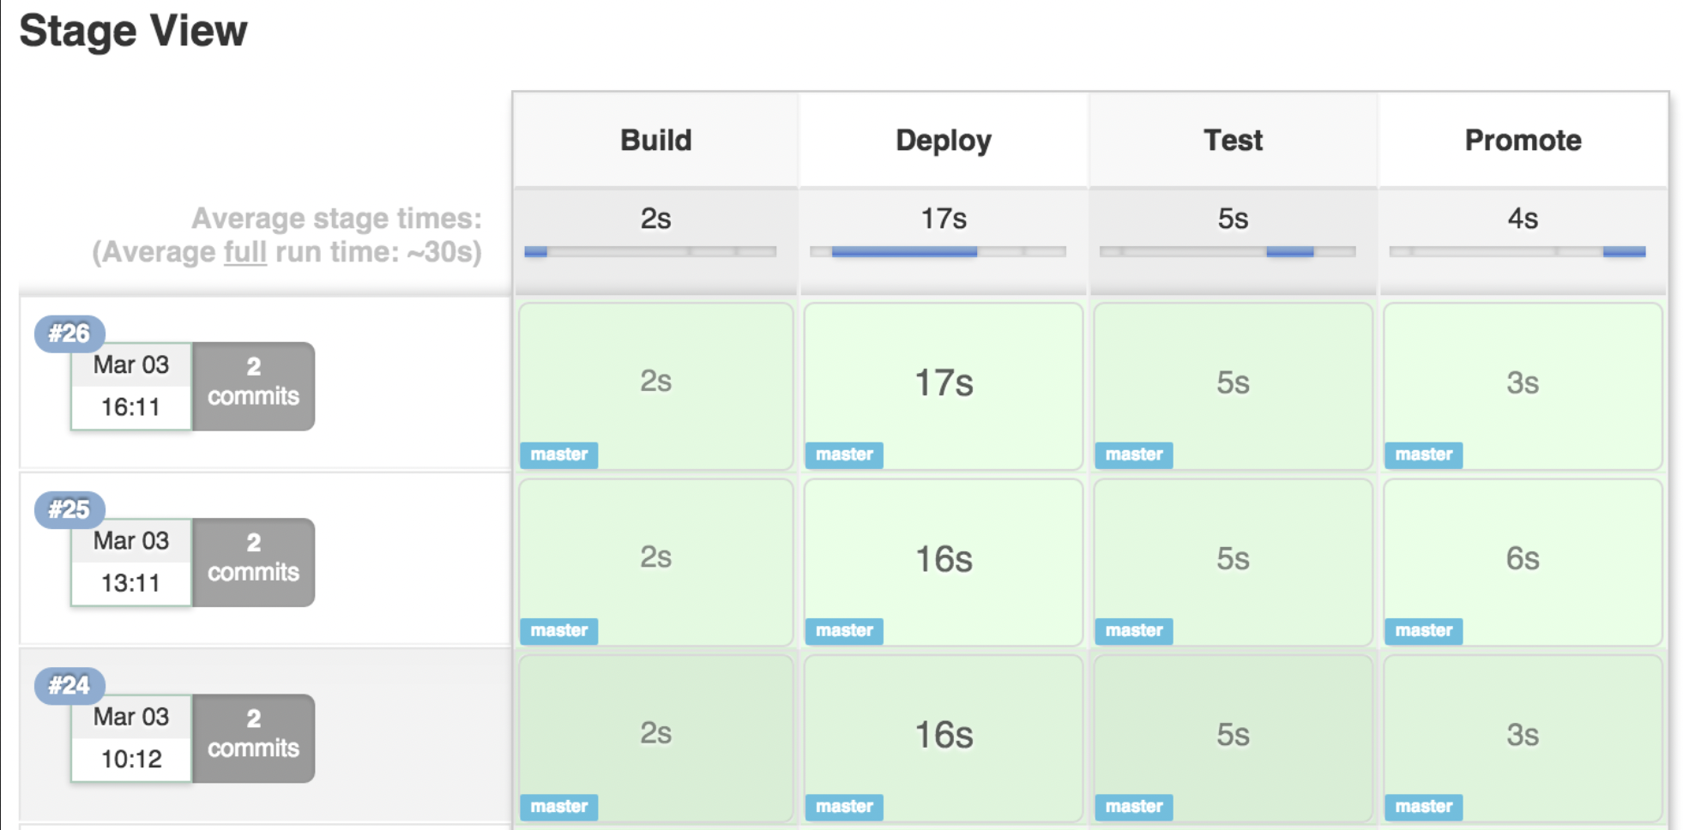
Jenkins Pipelines

Slide 30





Demo Architecture
Git push
Git webhook
Source code
Amazon Elastic Container Registry (Amazon ECR)
Amazon Elastic Container Service (Amazon ECS)

Slide 31
DEMO
Notes:
CI/CD stands for Continuous Integration and Continuous Deployment, and it’s a method used by development teams to build and release software in small, manageable parts. Imagine you’re working on a new feature for an app; instead of waiting until the end to test it all at once, CI/CD lets us automatically test and integrate each small change in real time. This way, we catch and fix issues early and often.
With Continuous Integration, we automatically test code every time it’s updated, so we know immediately if something doesn’t work as expected. Continuous Deployment means that once a change passes all tests, it can be quickly and safely rolled out to users without manual steps.
This approach not only speeds up development but also reduces the risk of big issues because we’re constantly ensuring everything works together. Overall, CI/CD helps us deliver new features, improvements, and bug fixes to users more efficiently and reliably.”
This explanation keeps it high-level and focuses on the benefits like faster delivery and reliability, making it relatable to non-technical stakeholders.

Slide 32
What are common issues that arise during pipeline runs, and how do you troubleshoot them?
Notes:
CI/CD stands for Continuous Integration and Continuous Deployment, and it’s a method used by development teams to build and release software in small, manageable parts. Imagine you’re working on a new feature for an app; instead of waiting until the end to test it all at once, CI/CD lets us automatically test and integrate each small change in real time. This way, we catch and fix issues early and often.
With Continuous Integration, we automatically test code every time it’s updated, so we know immediately if something doesn’t work as expected. Continuous Deployment means that once a change passes all tests, it can be quickly and safely rolled out to users without manual steps.
This approach not only speeds up development but also reduces the risk of big issues because we’re constantly ensuring everything works together. Overall, CI/CD helps us deliver new features, improvements, and bug fixes to users more efficiently and reliably.”
This explanation keeps it high-level and focuses on the benefits like faster delivery and reliability, making it relatable to non-technical stakeholders.

